Slide 1
Marginal Productivity
Theory

Slide 2
Marginal Physical Product
Extra Output from each additional unit of resource

Slide 3

Marginal Revenue Product
Price x Extra Output
Change in Total Revenue Resulting from the use of each additional unit of resource

Slide 4
MRP as Resource Demand
(1)
Units of
Resource
(2)
Total Product
(Output)
(3)
Marginal
Product (MP)
(4)
Product
Price
(5)
Total Revenue,
(2) X (4)
(6)
Marginal Revenue
Product (MRP)
0
1
2
3
4
5
6
7
0
7
13
18
22
25
27
28
7
6
5
4
3
2
1
$2
2
2
2
2
2
2
2
$ 0
14
26
36
44
50
54
56
]
$14
12
10
8
6
4
2
]
]
]
]
]
]
]
]
]
]
]
]
]
$18
16
14
12
10
Resource Wage
(Wage Rate)
8
6
4
D=MRP
2
0
1
2
3
4
5
6
7
-2
Quantity of Resource Demanded
12-<number>

Slide 5
Marginal Resource Cost
Amount which each additional unit of resource adds to a firms total (resource) cost

Slide 6
MRP=MRC Rule
It is profitable for a firm to hire additional units of a resource up to that point at which that resources MRP=MRC

Slide 7
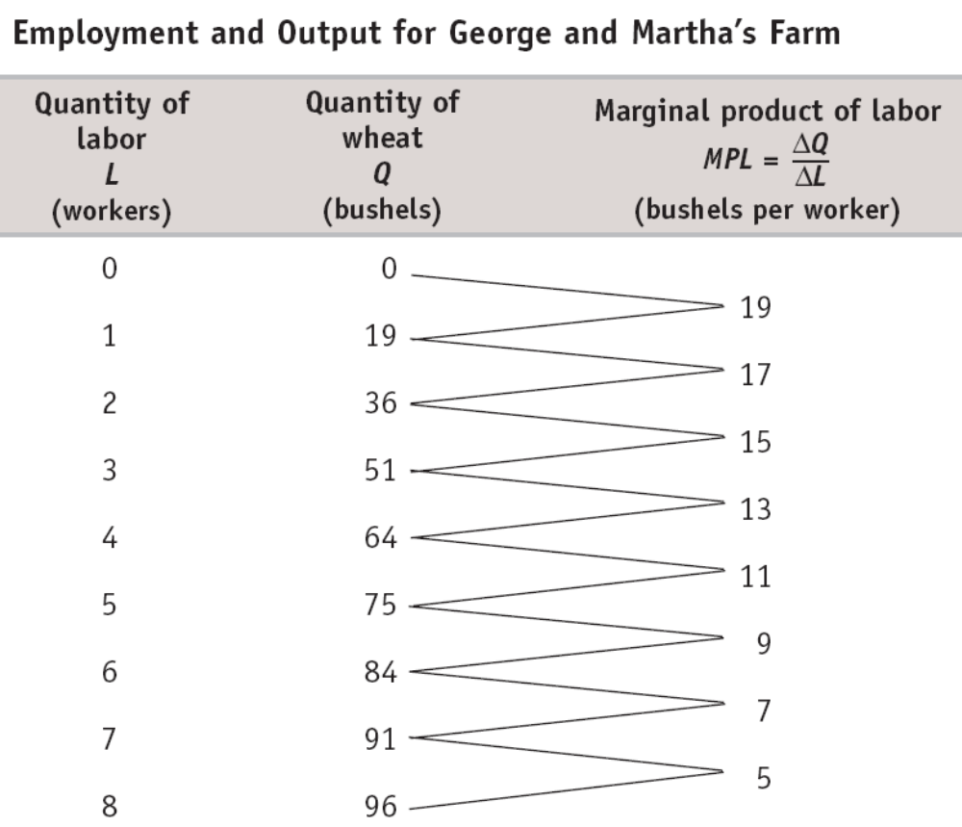

Slide 8
(a) Total Product
(b) Marginal Product of Labor
Quantity of wheat (bushels)
Marginal product of labor (bushels per worker)
100
TP
19
80
17
15
60
13
11
40
9
7
20
5
MPL
0
1
2
3
4
5
6
7
8
0
1
2
3
4
5
6
7
8
Quantity of labor (workers)
Quantity of labor (workers)
Notes:
Figure Caption: Figure 20-2: The Production Function for George and Martha’s Farm
Panel (a) shows how the quantity of output of wheat on George and Martha’s farm depends on the number of workers employed. Panel (b) shows how the marginal product of labor depends on the number of workers employed.

Slide 9
The Value of the Marginal Product Curve
Wage rate, VMPL
Optimal point
$400
300
A
Market wage rate
200
Value of the marginal product value curve
100
VMPL
0
1
2
3
4
5
6
7
8
Quantity of labor (workers)
Profit-maximizing number of workers
Notes:
Figure Caption: Figure 20-3: The Value of the Marginal Product Curve
This curve shows how the value of the marginal product of labor depends on the number of workers employed. It slopes downward because of diminishing returns to labor in production. To maximize profit, George and Martha choose the level of employment at which the value of the marginal product of labor is equal to the market wage rate. For example, at a wage rate of $200 the profit-maximizing level of employment is 5 workers, shown by point A. The value of the marginal product curve of a factor is the producer’s individual demand curve for that factor.

Slide 10
Project Estimation

Slide 11
Definition of estimating
‘To form an approximate notion of the amount, number, magnitude or position of anything, without actual enumeration or measurement.’
Oxford English Dictionary

Slide 12
What estimates are made in projects
Time estimates are used in scheduling work, and determining delivery dates.
Cost estimates are used for budgeting.
Cost and benefit estimates are used in cost/benefit analysis to determine the overall viability of a project.

Slide 13
Importance of accurate estimates
Inaccurate time estimates can result in inefficient use of resources and late delivery.
Inaccurate cost estimates can result in insufficient budget being allocated, or excess budget being set aside for the project when it could be used for other projects.
If the cost or benefits estimates are inaccurate this can lead to incorrect decisions about proceeding with the project being made.

Slide 14
Estimating methods
Three commonly used methods of estimating are:
Top down estimating
Bottom up estimating
Parametric estimating

Slide 15
Top-down method
Identify a previous project or section of a previous project that is similar to the current project.
Assess the extent to which the current project is similar to the previous project – the comparison factor (e.g 1.5 if the current project is estimated to be 50% larger).
Compute the estimate for the current project based on the actual durations, effort or costs from the previous project and the comparison factor.

Slide 16
Bottom-up method
The method uses the Work Breakdown Structure (WBS) developed during the planning stage of the project. Estimates are created for all tasks at the lowest level of the WBS and then these are accumulated to determine the estimates for the whole project.
One disadvantage of the bottom-up method is that it is much more time-consuming than other methods.

Slide 17
Parametric method
The parametric method is also known as the object based method.
It is used to obtain definitive estimates and to confirm bottom up estimates where possible.
A simple concept is used, namely:
If the amount of effort needed to carry out a particular activity for a particular object is known, and the number of objects is known, the effort required to perform the activity for all the objects can be determined.
The amount of effort for the single activity can be determined either from a standard, which has been established from previous experience, or by executing a sample activity if no standard exists.

Slide 18
Parametric method (Cont.)
Steps in deriving the estimate:
Identify an item to be estimated.
Estimate the number of items.
Estimate the effort per item.
Multiply effort per item by number of items to determine the total effort.
For example, if the assembly of one library shelving stack takes an hour and a half and there are 40 stacks to assemble then the total effort is 60 hours.

Slide 19
Estimating techniques
Three commonly used techniques for obtaining estimates are:
Weighted average estimating
Consensus estimating
Phase ratios

Slide 20
Weighted average estimates
Weighted average estimating is also known as sensitivity analysis estimating.
With this technique three estimates are obtained for each item rather than one. This provides a more accurate estimate than when only one estimate value is provided.
The three estimates are known as the best case (O = Optimistic), worst case (P = Pessimistic) and most likely (M = Median).
These are then used in the following formula to determine the estimated effort:
Estimated effort = (O + 4M + P ) / 6

Slide 21
Consensus estimating
Steps in conducting a consensus estimating session:
A briefing is provided to the estimating team on the project.
Each person is provided with a list of work components to estimate.
Each person independently estimates O, M and P for each work component.
The estimates are written up on the whiteboard.
Each person discusses the basis and assumptions for their estimates.
A revised set of estimates is produced.
Averages for the O, M and P values are calculated.
These averages are then used in the weighted averages formula to calculate the estimated effort.

Slide 22
Phase ratios
Project phase ratios provide a means of generating a top-down order of magnitude duration estimate for a project, or they can be used as a sense check of bottom-up duration estimates of the time allocated to each project phase.
Phase ratio estimating uses an estimate for one phase of a project to derive the likely size of the other phases, and hence an overall estimate for the project.
For example, if analysis takes 5 weeks, and this represents 10% of the project, then the project is likely to take 50 weeks.
The concept behind this method is that similar types of projects would normally spend the same percentage of time in each phase.
Phase ratios are not accurate enough to be used as a budget or definitive estimates.

Slide 23
Phase ratio percentages
The phase ratio technique is based on studies that average the proportion of time that a large sample of projects has spent on standard project phases. An initial set of project phase ratios is provided below.
These should be refined based on results from completed projects.
Phase Ratio
Initiation 5%
Planning 20%
Analysis 10%
Design 10%
Construction 20%
Testing 20%
Implementation 10%
Closure 5%

Slide 24
Estimating assumptions
An estimate is a qualified guess.
Every estimate is based on assumptions.
An estimate assumption is a statement which has been considered to be true in deriving the estimate.
These estimate assumptions need to be specified so that the basis of the estimate is known and validity of the assumptions can be assessed.
For example, a work effort estimate is usually based on a level of skill and expertise. If a lower level of skill and expertise is utilised then it is likely that the task will
require more effort.

Slide 25
Applying contingency to estimates
Can be applied to each project stage or to each task. It provides a buffer to absorb the impact of dealing with unforeseen issues or complexities in completing the task or stage.
Assess the uncertainty of the estimate and the level of risk.
Assess the length of time between when the estimate is produced and when the estimated task or stage is likely to be executed.
For example, if there are four sequential stages to a project, then there is more uncertainty about the last stage than the first and hence the contingency for the last stage should be greater.
Apply an increase to the estimate as a contingency in line with the uncertainty, risk and the length of time to execution. Apply the contingency as a percentage of the estimate, 10% is often used as an average.

Slide 26
Recommended estimating principles
Always obtain at least two estimates.
Involve the people who will be doing the work (or with the skills to do the work if resources have not yet been allocated) in the estimating process and the people who require the work done where possible.
Use more than one estimating method.
Each estimate must be independently derived.
Review the estimates and rationalise the differences.
Document assumptions made
Add contingency based on the level of uncertainty and risk.
Get agreement and commitment from the project team for their task estimates and also from the project sponsor for the overall project estimate.
Review and refine the estimates as the project proceeds
based on progress.

Slide 27
Verification of estimates
Estimates need to be reviewed to check they are realistic.
Using more than one method of estimating and/or two or more independent estimators to produce estimates, then comparing these provides a very effective verification of the estimates.
For example, phase ratios is a useful technique for checking estimates derived by other means.
As tasks progress, regularly obtain updated estimates of effort, and time to complete the tasks from the resources performing the tasks. These are called “revised estimates” and should be used to keep project
schedules continually up to date.

